Slide 1
PHY CH 36

Slide 2
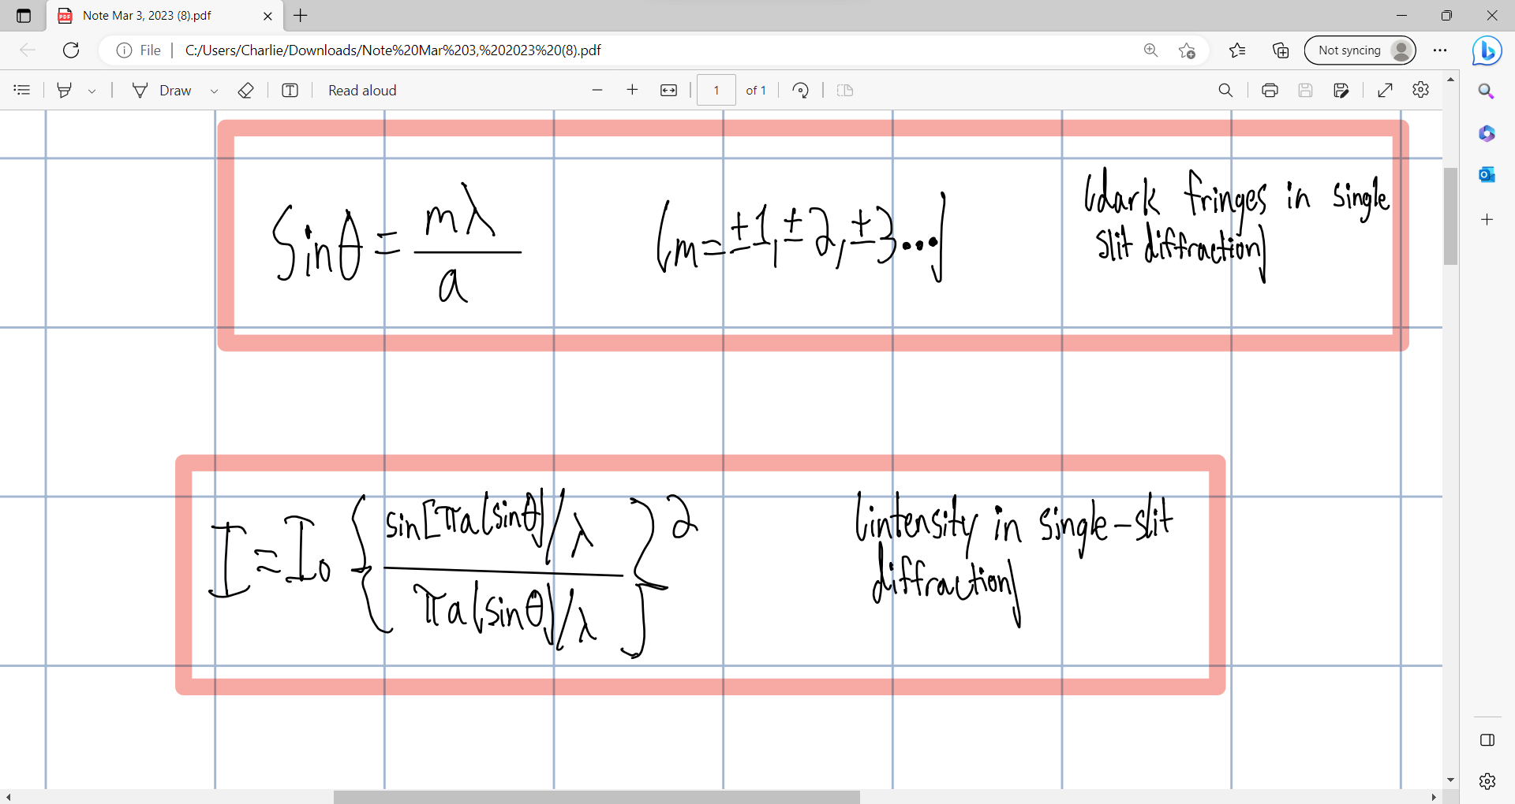

Slide 3
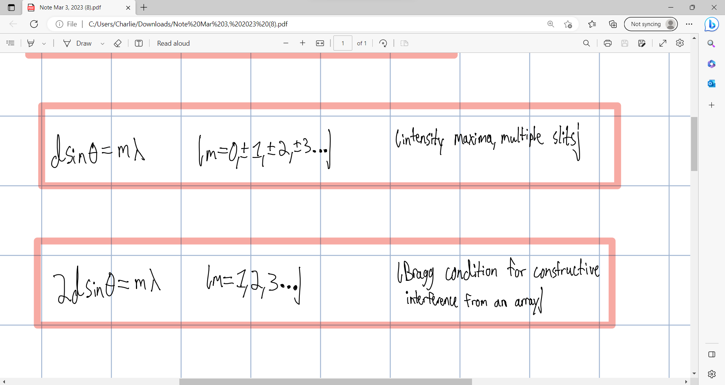

Slide 4
